Slide 1
“BOOK RECOMMENDATION SYSTEM”
a project of
MACHINE LEARNING

Slide 2
“GROUP MEMBERS”
STUDENT NAME | STUDENT ID
Muhammad Abdullah Shahid | F2019027004
Muhammad Muzamil | F2019027042
Amina Ashfaq | F2019027010
Zirwa Waqar | F2019027020
Sidra Kalsoom | F2019027037

Slide 3
What is A Recommendation System?
Personalized Preferences.
Information Filtering Technique.
Selection of Interested.
System of Intelligence.
Information Overload Problem.

Slide 4
WHY?
Lot of Choices.
Selection of Interested Item.
Share Preferences.
Decision Making.

Slide 5
HOW?
“COLLABORATIVE FILTERING APPROACH”
Matches the people of similar taste.
“CONTENT-BASED APPROACH”
Based on the user’s History.

Slide 6
“APPLICATIONS”
Selecting Books and newspaper.
Selecting best Movies,
Selecting Restaurants.
Selecting Home Items.
Selecting Cloths Online.

Slide 7
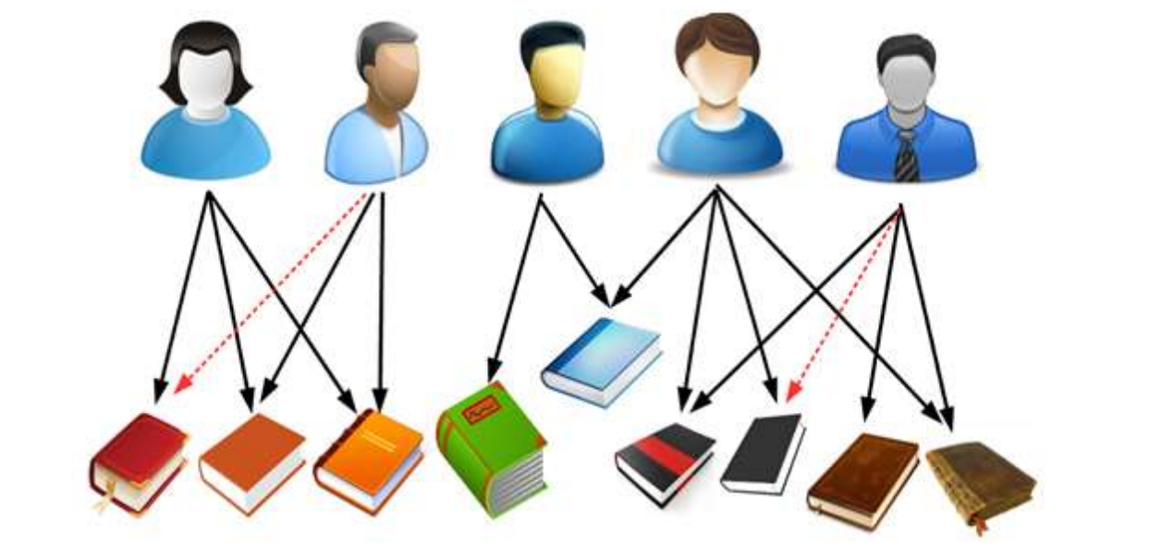
“OUR RECOMMENDATION SYSTEM”
“A BOOK RECOMMENDATION SYSTEM”

Slide 8
“Book Recommendation System” using “COLLABORATING FILTERING APPROACH”
Description Base Recommendation System
Rating And Review Base Recommendation System
Authors and Publisher Base Recommendation System

Slide 9
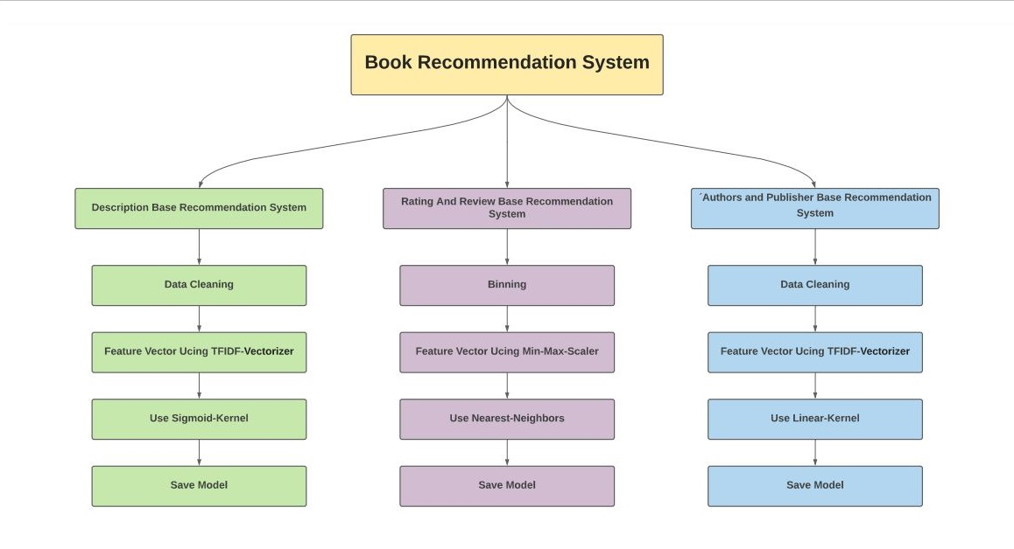

Slide 10
Used Dataset
Good Book Dataset (Kaggle)
Ten CSV Files
Nine unique Features
Shape of Dataset is (538282, 9)

Slide 11
“DESCRIPTION BASE RECOMMENDATION SYSTEM”
Work on Description column
Clean Data ( remove duplication, null values, stope words, punition, symbols etc)
Convert info Feature Vector Using TFIDF-Vectorizer
Feature Unigram, Bigram, Trigram
Train Sigmoid-Kernel and Linear-Kernel
Reduce The Model Size
Save Trained Model

Slide 12
“RATING AND REVIEW BASE”
Work on Rating and Reviews columns
Convert Continues data in small Bins
Convert info Feature Vector Using Min-Max-Scaler
Find top Eleven Nearest Neighbors
Save Trained Model

Slide 13
“AUTHORS AND PUBLISHER BASE”
Work on Author and Publishers columns
Clean Data ( remove duplication, null values, stope words, punition, symbols etc)
Convert info Feature Vector Using TFIDF-Vectorizer
Feature char n-3 Gram
Train Linear-Kernel
Reduce The Model Size
Save Trained Model

Slide 14
“LOADING AND TESTING OF TRAIN MODELS”
Use Pickle Library to Save and Load Train Model
Load All Trained Models
Define Function To Find Prediction
Test All Models

Slide 15
“Application Phase”
Use Flask For Generate Rest API
Generate a Live API Link
Build An Android Application for Recommendation System
Select a Recommendation System
Select a Book Than System will Recommend the Most Similar

Slide 16
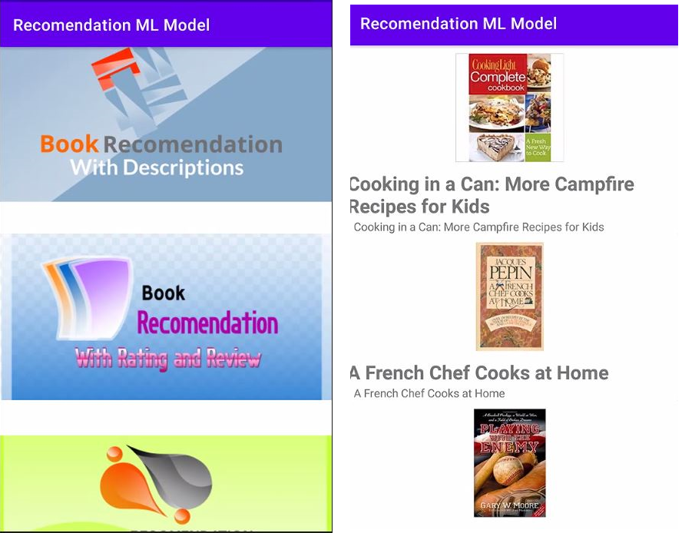

Slide 17
